Slide 1
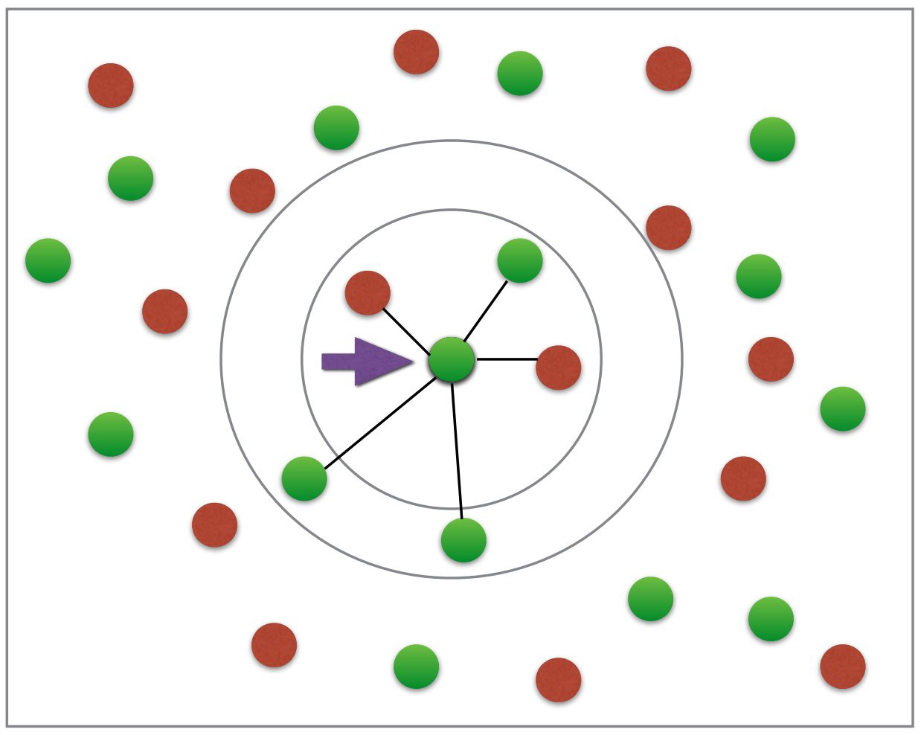
K- NEAREST NEIGHBOUR

Slide 2
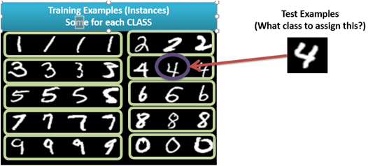
1-Nearest Neighbor Classifier

Slide 3
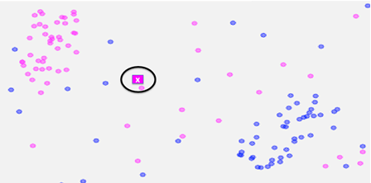
1-Nearest Neighbor

Slide 4
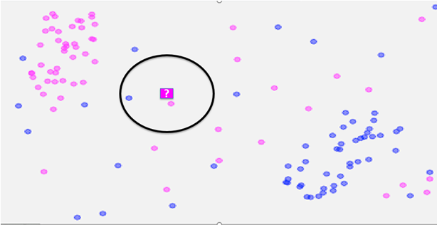
2-Nearest Neighbor

Slide 5
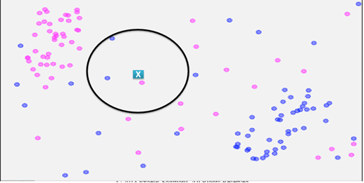
3-Nearest Neighbor

Slide 6
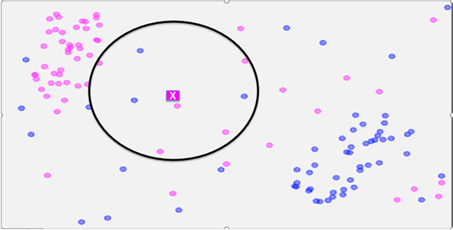
8-Nearest Neighbor

Slide 7
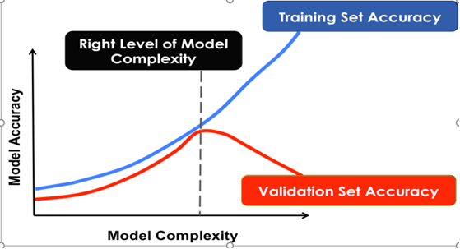
Controlling COMPLEXITY in k-NN

Slide 8
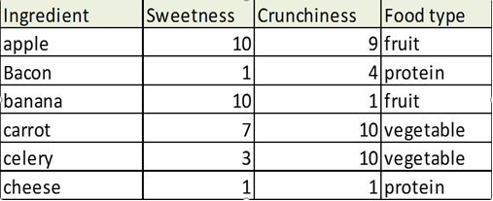
Example

Slide 9
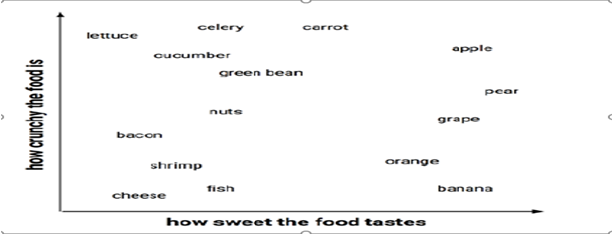

Slide 10
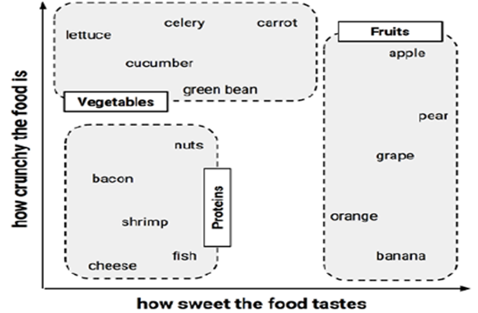

Slide 11
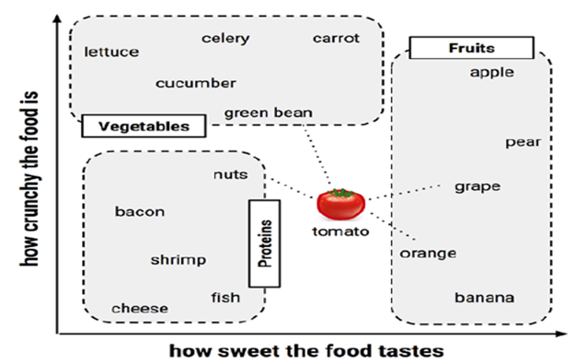

Slide 12

Measuring similarity with distance
Which Class Tomato belongs to given the feature values:
Tomato (sweetness = 6, crunchiness = 4)

Slide 13
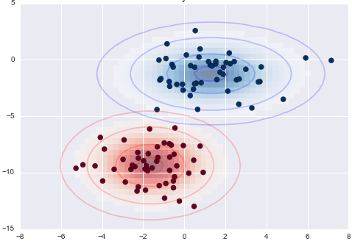
NAÏVE BAYES

Slide 14
Understanding probability
The probability of an event is estimated from the observed data by dividing the number of trials in which the event occurred by the total number of trials
For instance, if it rained 3 out of 10 days with similar conditions as today, the probability of rain today can be estimated as 3 / 10 = 0.30 or 30 percent.
Similarly, if 10 out of 50 prior email messages were spam, then the probability of any incoming message being spam can be estimated as 10 / 50 = 0.20 or 20 percent.
For example, given the value P(spam) = 0.20, we can calculate P(ham) = 1 – 0.20 = 0.80
Note: The probability of all the possible outcomes of a trial must always sum to 1

Slide 15
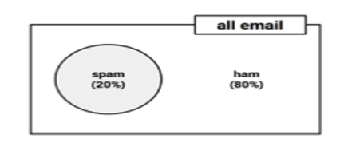
Understanding probability
For example, given the value P(spam) = 0.20, we can calculate
P(ham) = 1 – 0.20 = 0.80
Because an event cannot simultaneously happen and not happen, an event is always mutually exclusive and exhaustive with its complement
The complement of event A is typically denoted Ac or A'.
Additionally, the shorthand notation P(¬A) can used to denote the probability of event A not occurring, as in P(¬spam) = 0.80. This notation is equivalent to P(Ac).

Slide 16
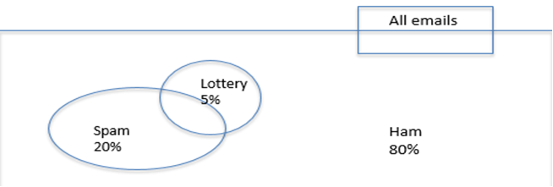
Understanding joint probability
Often, we are interested in monitoring several non-mutually exclusive events for the same trial.

Slide 17
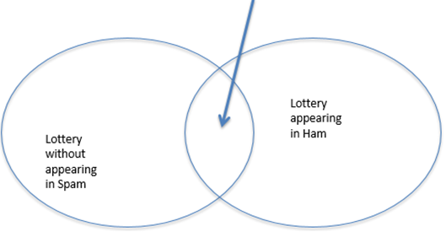
Understanding joint probability
Lottery appearing in spam
Estimate the probability that both P(spam) and P(Spam) occur, which can be written as P(spam ∩ Lottery). the notation A ∩ B refers to the event in which both A and B occur.

Slide 18
Understanding joint probability
Calculating P(spam ∩ Lottery) depends on the joint probability of the two events or how the probability of one event is related to the probability of the other.
If the two events are totally unrelated, they are called independent events.
If P(spam) and P(Lottery) were independent, we could easily calculate P(spam ∩ Lottery), the probability of both events happening at the same time.
Because 20 percent of all the messages are spam, and 5 percent of all the e-mails contain the word Lottery, we could assume that 1 percent of all messages are spam with the term Lottery.
More generally, for independent events A and B, the probability of both happening can be expressed as P(A ∩ B) = P(A) * P(B).
0.05 * 0.20 = 0.01

Slide 19
Bayes Rule
P(A|B) = P(A ∩ B)/P(B) = P(B/A)P(A)/P(B)
Bayes Rule: The most important Equation in ML!
P(CLASS/DATA) = P(CLASS) P(DATA/CLASS)/P(DATA)
Probability of class after seeing the data
Data likelihood given class
Class Prior
Data Prior (Marginal)

Slide 20
Naïve Bayes Classifier

Slide 21
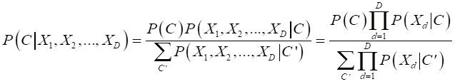

Naïve Bayes Classifier
Conditional Independence among variables given Classes!
Simplifying assumption
Baseline model especially when large number of features
Taking log and ignoring denominator:

Slide 22

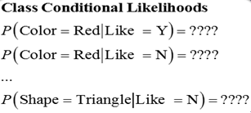
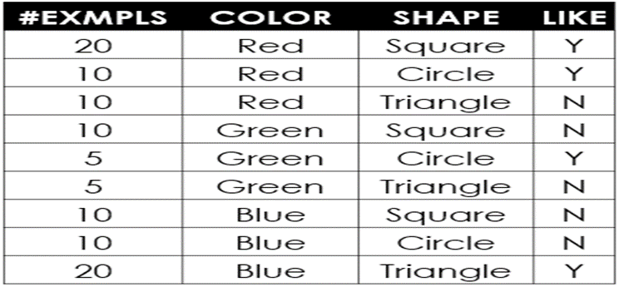

Naïve Bayes Classifier for Categorical Valued Variables

Slide 23
NEXT TOPIC> ANN & SVM

